Slide 1


Thermal analysis of a 2U CubeSat
Team 18
Parker Southwick, Jeremy Lowman, Katherine Popchock ,Thomas Otero, Tyler Benson and Griffin Johnson

Slide 2
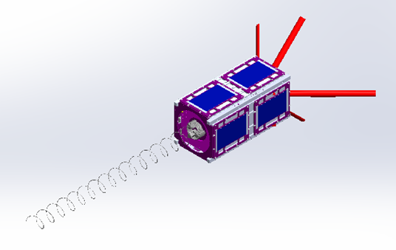
Our CubeSat
2U CubeSat
Project under the CubeSat Launch Initiative (CSLI), NASA Oregon Space Grant Consortium (OSGC) and the Portland State Aerospace Society (PSAS)
Our goal:
Develop an accurate ANSYS model to understand the thermal states that the satellite will undergo at various beta angles and attitudes

Slide 3
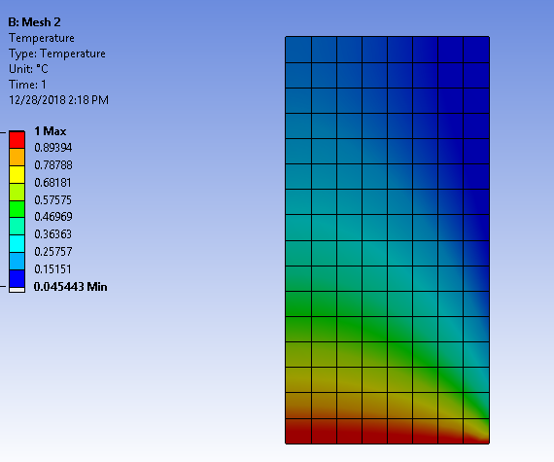
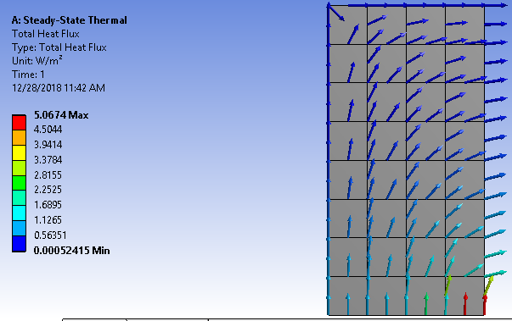
A Sample of ANSYS
Simple 2D heat transfer problem: conduction at the bottom boundary, insulated sides on the left and top boundaries and convection on the right boundary

Slide 4
Progress
Identified appropriate training modules
ANSYS certificates have been earned/made large dents in training progress as a whole
Timeline established for finishing fixing the vacuum chamber

Slide 5
Timeline
Winter term
Complete ANSYS certification
Hand calculations for 1D and 2D complete
1D and 2D results gathered
Begin hand calculations for 3D and creating plausible meshes
Spring term
2D results gathered, begin 3D analysis
Begin verification of simulation data in vacuum chamber
Mesh refinement, continue physical testing
Post-processing of data
Provide actionable suggestions to the OreSat team for attitude control of the satellite

